Slide 1

DIGITAL DEWA
Strategic Vision Document | 2026
EDUCATION TRANSFORMATION
AI-Native Learning &
School Management Platform
A Strategic Vision for Transforming Education Through Artificial Intelligence
Intelligence-First
Human-Centered
Outcome-Driven
Architecture
Design
Results
Prepared for Educational Leadership
UAE Focus | February 2026

Slide 2
EXECUTIVE SUMMARY
VISION
The Strategic Imperative
AI-Native Education
The Vision
Why This Matters Now
We envision a next-generation AI-Native Learning & School Management Platform that unifies Learning Management (LMS) and School ERP into a single, intelligent ecosystem. Unlike traditional systems where AI is bolted on as an afterthought, this platform is architected from the ground up with artificial intelligence as its foundational layer—creating a continuously learning, self-improving educational environment .
1
National Mandate
UAE requires AI curriculum in all K-12 schools starting 2025-2026, creating infrastructure requirements
2
Teacher Crisis
GCC schools face severe teacher shortages; AI automation can reduce workload by 40%
3
Competitive Advantage
Strategic Alignment
Early adopters will establish regional leadership in AI-powered education
This vision directly supports UAE's National AI Strategy 2031 and the groundbreaking AI education mandate requiring AI curriculum in all K-12 schools from the 2025-2026 academic year. By positioning AI as essential educational infrastructure, the UAE is creating a unique opportunity for institutions to lead regional transformation.
4
Market Opportunity
GCC AI education market valued at $1.2B (2024), projected to reach $5.1B by 2030
UAE AI Mandate
|
20% GDP Target by 2031
Three-Pillar Value Proposition
"Every government department will be assessed on AI usage and benefit."
Personalized Student Experiences
Empowered Teachers
Data-Driven Leadership
— Omar Al Olama, UAE Minister of State for AI

Slide 3
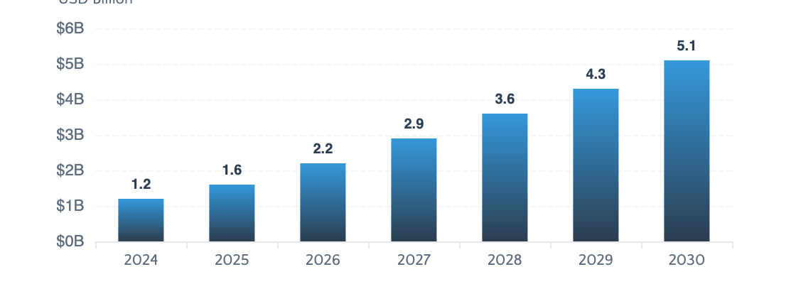
STRATEGIC CONTEXT
The UAE Context: A Nation Leading AI Education
UAE AI Education Mandate
GCC AI Education Market
In May 2025, the UAE approved a nationwide rollout of AI education for all students in government schools, from kindergarten to Grade 12, starting from the 2025-2026 academic year. This makes the UAE one of only two nations globally (alongside China) to mandate AI education at this scale.
Market size and growth trajectory
Curriculum Coverage (7 Key Areas):
Foundational AI concepts
Data & algorithms
AI tools & software
Ethics & awareness (25%)
Real-world applications
Innovation & project design
Policy & community
$1.2B
35%
$5.1B
2024 Market
CAGR
2030 Projection
1,000+
1M+
K-12
Teachers Trained
Students Annually
All Grade Levels
Strategic Opportunity
Digital Economy Strategy 2031
Traditional LMS systems are reactive and fragmented. UAE's mandate requires predictive, AI-native platforms that continuously monitor, track, and recommend interventions—creating a strategic opportunity to lead regional educational transformation.
The UAE's Digital Economy Strategy targets increasing the digital economy's contribution to GDP from 11.7% (2021) to over 20% by 2031. AI is positioned as a cornerstone of this transformation.
$96B
Top 10
Key Insight: Early adopters will establish competitive advantage and regional thought leadership
AI Contribution by 2030
Global AI Leader Target

Slide 4
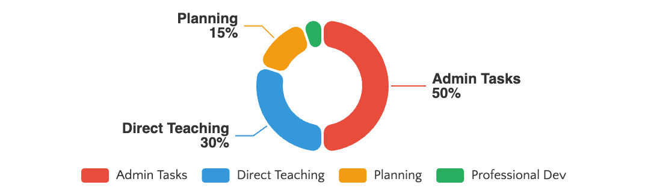
CURRENT STATE ANALYSIS
The Challenge: Why Traditional Systems Fall Short
Reactive, Not Predictive
Fragmented Data Silos
One-Size-Fits-All
Traditional systems report what happened, not what will happen. Educators discover student struggles after grades drop, missing critical intervention windows.
Academic, administrative, and wellbeing data exist in disconnected systems, preventing holistic student understanding and comprehensive insights.
Legacy platforms cannot deliver personalized learning at scale, forcing all students through identical curricula regardless of individual needs or pace.
Teacher Workload Crisis
Leadership Blind Spots
Teachers spend up to 50% of working hours on administrative tasks—lesson planning, grading, reporting, and paperwork—time diverted from student interaction and personalized instruction.
No predictive insights for enrollment, resource needs, or student outcomes
Delayed identification of at-risk students and cohort trends
Manual reporting processes consuming administrative resources
Limited visibility into teacher productivity and engagement
The Cost of Inaction
40%
25%
Teacher Turnover Risk
Students Underserved
Source: UK Department for Education, 2025; Global Education Surveys
6-12 mo
$Ms
Delayed Interventions
Inefficient Resources

Slide 5

TRANSFORMATIONAL VISION
The Vision: An AI-Native Educational Ecosystem
AI-Native Architecture
Unlike traditional systems where AI is bolted on as an afterthought, this platform is architected from the ground up with artificial intelligence as its foundational layer . Every module, workflow, and interaction is designed with continuous intelligence, predictive analytics, and adaptive learning capabilities embedded at the core.
Continuous Intelligence
Predictive Analytics
Adaptive Learning
AI actively monitors, tracks, and analyzes every dimension of student development—academic performance, extracurricular activities, wellbeing metrics, and behavioral patterns—in real-time.
Machine learning models forecast academic trajectories, identify at-risk students before issues manifest, and predict resource needs—enabling proactive intervention rather than reactive response.
Content difficulty, pacing, and instructional approaches automatically adjust to each student's comprehension level, learning style, and progress—delivering true personalization at scale.
The Self-Improving Educational Environment
1
2
3
4
Data Collection
Pattern Recognition
Predictive Modeling
Adaptive Response
Multi-dimensional student data
AI identifies trends & insights
Forecast outcomes & risks
Personalized interventions

Slide 6
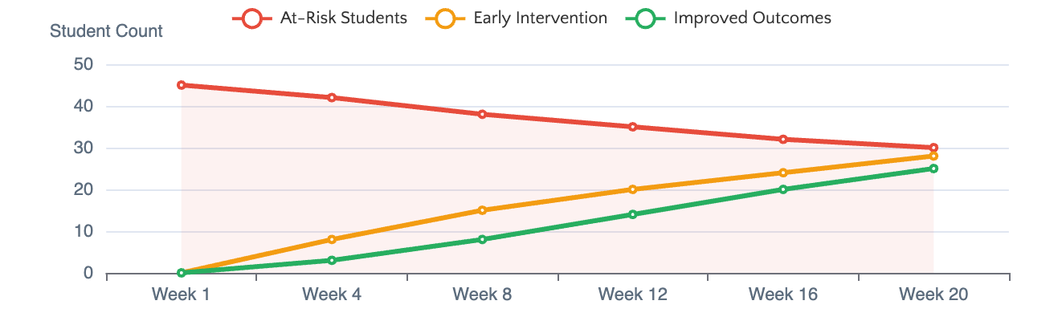
PILLAR 1
STUDENT-CENTRIC
360° Student Intelligence
Holistic View
12-Dimensional Tracking Framework
Predictive Student Success Model
Comprehensive student development record
AI-powered early warning system
Academic
Certifications
Sports & Activities
Internships
Financial Literacy
Personal Dev
Achievements
Career Profile
Wellbeing
Counselor Inputs
93%
92%
6-8 wks
Social Skills
Community
Grade Prediction Accuracy
Retention Prediction
Early Warning Lead Time
AI Intelligence Features
Personalized Learning Paths
Career Guidance Engine
Risk Detection
AI creates individualized learning journeys that adapt to each student's pace, style, and proficiency level.
AI-driven career exploration aligned with student interests, strengths, and labor market trends.
Automated alerts for academic or wellbeing concerns
Trajectory Forecasting
Performance prediction models with 90%+ accuracy
Pathway Suggestions
Adaptive content difficulty
Skills-to-career mapping
Personalized academic and career recommendations
Personalized resource recommendations
Industry trend analysis
Real-time progress adjustment
Internship matching

Slide 7
PILLAR 2
TEACHER EMPOWERMENT
Teacher AI Co-Pilot
40% Workload Reduction
AI Lesson Planning Assistant
Assessment Generator
Automatically generates complete lesson plans with learning objectives, activities, assessments, and differentiation strategies aligned to curriculum standards.
Creates differentiated worksheets, quizzes, and assessments tailored to student proficiency levels with auto-grading and detailed analytics.
Time Savings
3-5 hours/week
Time Savings
4-6 hours/week
Automated Grading
Progress Reporting
Real-Time Insights
AI-powered grading for objective questions and rubric-based assessment of written work with instant feedback generation.
AI-generated progress summaries, report card comments, and parent communications in natural language.
Instant visibility into class performance, learning gaps, and student engagement patterns to inform instruction.
Sample Output:
Skill gap identification
Multiple Choice
100% auto
"Sarah has shown remarkable improvement in mathematical reasoning this term, particularly in problem-solving applications..."
Curriculum alignment check
Short Answer
80% auto
Engagement analytics
Essay (rubric)
60% auto
Teacher Impact Summary
5+
40%
2x
Reclaiming time for what matters most: student interaction and personalized instruction
Hours Saved/Week
Workload Reduction
Student Face Time

Slide 8
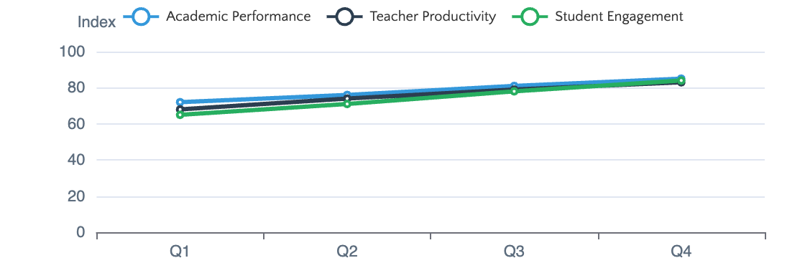
PILLAR 3
EXECUTIVE VIEW
Leadership Intelligence & Operations
Strategic Insights
Executive Intelligence Dashboard
Leadership Analytics Overview
Real-time strategic insights across all school operations, enabling data-driven decision making at the leadership level with predictive analytics and trend forecasting.
Real-time operational intelligence
Academic Trends
Cohort Tracking
School-wide performance with YoY comparisons
Grade-level analytics with benchmarks
Risk Segmentation
Strategic Forecasting
AI-identified at-risk students
Enrollment & resource predictions
Operations Automation
Compliance & Governance
Resource Optimization
Enrollment Management: End-to-end admissions, registration, transfers
Role-Based Access: Student, Teacher, Parent, Admin, Counselor
Teacher Utilization: Productivity insights and workload balancing
Attendance Tracking: AI-powered pattern analysis
Audit Trails: Complete activity logging
Facility Management: Space utilization analytics
Timetable Optimization: Intelligent scheduling with conflict detection
Data Privacy: UAE Data Protection Law compliance
Budget Forecasting: AI-driven financial projections
Reporting: Inspection-ready documentation
Custom Reports: Self-service analytics builder
Notification Engine: Multi-channel automated alerts

Slide 9
TECHNOLOGY ENABLERS
AI Capabilities: Transforming Educational Outcomes
Predictive Analytics
Natural Language Processing
Recommendation Engines
Machine learning algorithms analyze historical academic data, attendance patterns, and behavioral indicators to forecast performance trajectories with high accuracy.
AI-powered generation of comprehensive student progress reports, performance commentaries, and parent communications in natural, contextual language.
Personalized recommendation systems that suggest optimal learning resources, study strategies, extracurricular activities, and career pathways.
Grade Prediction
93%
Progress reports
Learning paths
Parent updates
Resources
Risk Identification
92%
Teacher notes
Career guidance
AI Content Generation
Gamification & Adaptive Learning
Leverage generative AI to automatically create lesson plans, differentiated worksheets, assessment questions, project ideas, and learning activities aligned with curriculum standards.
Adaptive learning models that adjust content difficulty in real-time based on student performance, combined with gamification elements to enhance engagement.
Adaptive Difficulty
Real-time
Lesson Plans
Worksheets
Points & Badges
Motivation
Assessments
Projects
Avatars & Rewards
Engagement
The AI-Native Difference
100%
AI is not an add-on feature—it's the foundational intelligence layer that powers every capability
AI-Integrated

Slide 10
IMPLEMENTATION STRATEGY
Implementation Roadmap: Phased Transformation
1
Foundation
2
Core Platform
3
AI Integration
4
Deployment
Months 1-2
Months 3-5
Months 6-8
Months 9-10
Requirements Definition: Stakeholder workshops, scope confirmation
LMS Core: Course management, content delivery
AI Engine: Model training, deployment
UAT: End-to-end validation
Predictive Scoring: Risk detection, forecasting
Performance: Load testing, tuning
UX Design: User journeys, interface mockups
Student Tracking: Life progress intelligence system
Security Audit: Vulnerability assessment
Teacher Co-Pilot: Lesson builder, assessments
Architecture Setup: Infrastructure provisioning
ERP Base: Enrollment, attendance, timetables
Training: User guides, workshops
Analytics Pipeline: Dashboards, reporting
Data Design: Schema, relationships, security
Access Control: Authentication, authorization
MILESTONE
Go-Live & Production
MILESTONE
MILESTONE
MILESTONE
AI-Enabled System Ready
Approved Architecture & UI
Functional Core System
Development Approach
Risk Mitigation
Success Factors
Methodology
Agile / Scrum
Phased rollout with pilot groups
Executive sponsorship and commitment
Sprint Duration
2 Weeks
Continuous stakeholder engagement
Cross-functional implementation team
Stakeholder Reviews
Bi-weekly
Iterative delivery with feedback loops
Change management and training investment

Slide 11
HUMAN-CENTERED TRANSFORMATION
Change Management: Ensuring Successful Adoption
ADKAR Change Management Framework
Comprehensive Training Program
Implementing AI-native platforms requires structured change management. The ADKAR model provides a proven framework for guiding individuals through transformation.
Leadership Workshops
Strategic vision and dashboard utilization
Teacher Training
A
Awareness
AI co-pilot tools, lesson planning, assessment
Communicate why change is necessary
Administrator Sessions
ERP workflows, reporting, student management
D
Desire
Parent Orientation
Build buy-in and personal motivation
Portal access, progress tracking, communication
K
Knowledge
Provide training on new tools and processes
Building Internal Champions
A
Ability
Identify and empower early adopters across all stakeholder groups to serve as AI champions and peer mentors.
Support hands-on practice and skill building
R
Reinforcement
15-20%
3:1
Celebrate wins and sustain momentum
Champions
Peer Support Ratio
Executive Sponsorship
Phased Rollout Strategy
Continuous Feedback Loops
Visible leadership commitment is critical. Executives must communicate the vision, allocate resources, and model platform adoption.
Start with pilot groups, gather feedback, iterate, and expand. Early wins build confidence and demonstrate value.
Regular surveys, focus groups, and support channels ensure user concerns are heard and addressed promptly.

Slide 12
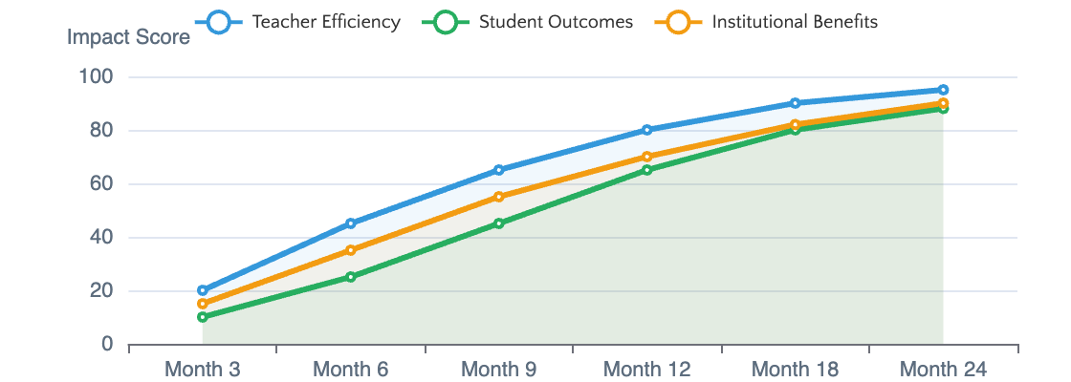
SUCCESS METRICS
Expected Outcomes & Success Metrics
Teacher Impact
Student Outcomes
Institutional Benefits
Workload Reduction
40%
Engagement Improvement
25-30%
Parent Satisfaction
+35%
Admin Time Saved
5+ hrs/week
Learning Outcomes
20-25%
Teacher Retention
+20%
Face Time Increase
2x
At-Risk Detection
90%+
Decision Speed
5x faster
Projected Impact Timeline
Key Performance Indicators
Cumulative benefits over implementation
30%
6-8 wks
Higher Test Scores
Early Warning
50%
100%
Faster Reporting
UAE Compliance
Return on Investment
Efficiency gains and improved outcomes deliver measurable ROI through reduced administrative costs and enhanced educational quality.
12-18
3-5x
Month Payback
5-Year ROI

Slide 13

THE PATH FORWARD
Leading Education Transformation
The UAE's AI education mandate creates an unprecedented opportunity to establish regional leadership in AI-powered learning. This vision positions your organization at the forefront of educational innovation.
Strategic Vision
Stakeholder Value
Competitive Edge
Align with UAE's national AI strategy and position as a regional EdTech leader
Empower students, teachers, and leaders with AI-driven insights and capabilities
Early adoption delivers sustainable competitive advantage in education quality
Next Steps
1
2
3
4
Begin your AI-native education transformation journey
Internal Alignment
RFP Development
Vendor Selection
Implementation
Digital DEWA | Strategic Vision Document | February 2026

